Slide 1
Theme
It’s All About “Themessage”

Slide 2
What is THEME?
The message or lesson that the story conveys about life.
A universal truth.
It’s the heart of the story!

Slide 3
What THEME is NOT!
NOT the subject!
NOT the topic!

Slide 4
Both fall under MAIN IDEA
Subject / topic
theme
What the text is about
The lesson or message about life

Slide 5
Theme vs. Subject / Topic
THEME | SUBJECT / TOPIC
Is the MESSAGE / LESSON about LIFE the story conveys | Is the SUBJECT or TOPIC the story is about.
Expressed in a full sentence. | Usually expressed in a word or two.
Example – Good will always triumph over evil. | Example – Luke Skywalker v. Darth Vader

Slide 6
Theme v. Plot
THEME | PLOT
Is the MESSAGE / LESSON about LIFE the story conveys | Is the CONFLICT or problem in the story.
Involves the MESSAGE of the story. | Involves the major EVENTS in the story.
“This story TAUGHT me that … “ | “This story is ABOUT …”

Slide 7
So … now that I know what THEME is… how do I DISCOVER the theme of a story?

Slide 8
How do we discover the THEME?
What happens to the central characters?
What does the main character learn?
Notice repeating patterns / symbols
What are the details in the story?
What greater meaning do they have?
The theme will TRANSFER from the text into our real world.
In other words, the MESSAGE will work in both the text AND our world!

Slide 9
When stating the theme …
It can’t be too specific …
it’s not – build a strong house in case a wolf comes
Restate in terms that apply to ALL human beings!
… always think ahead and be prepared!

Slide 10
THEME must be JUSTIFIED
You MUST be able to SUPPORT your theme with specific EVIDENCE from the text!
For example – if your theme is, “Poverty creates tough, self-reliant people.”, then the book should contain examples of poor characters who develop toughness and self-reliance.

Slide 11
Common universal themes …
Your turn …
Make a list of all the themes you can think of!
Can you narrow this list? Do you see any common elements?

Slide 12
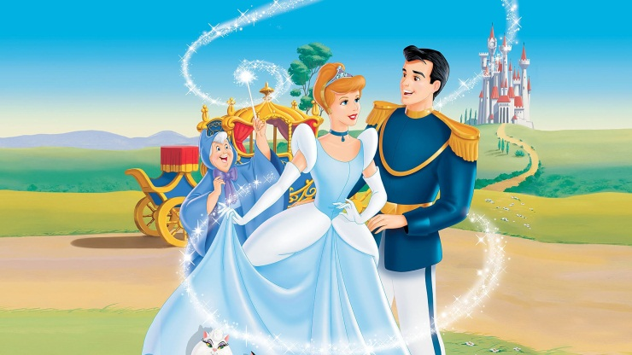
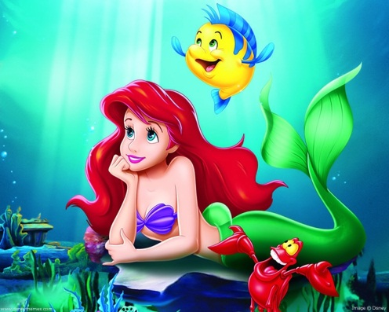
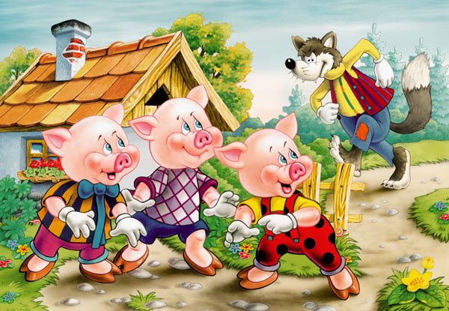
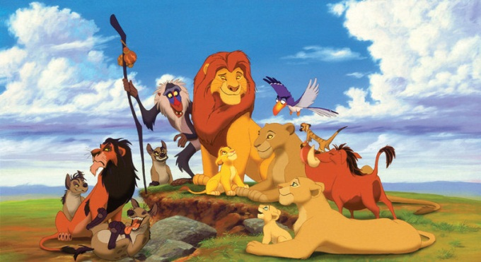
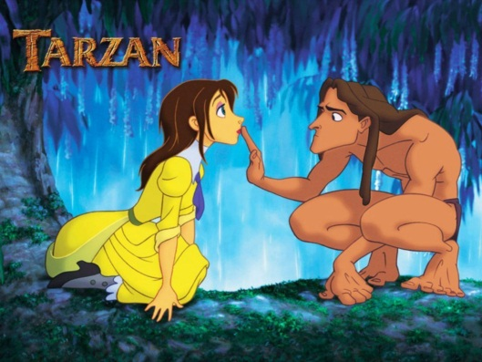
Let’s look at some examples … … what is the subject? … what is the theme? … do we see multiple themes? … do we see common themes?

Slide 13
Let’s look at examples of some universal themes!

Slide 14
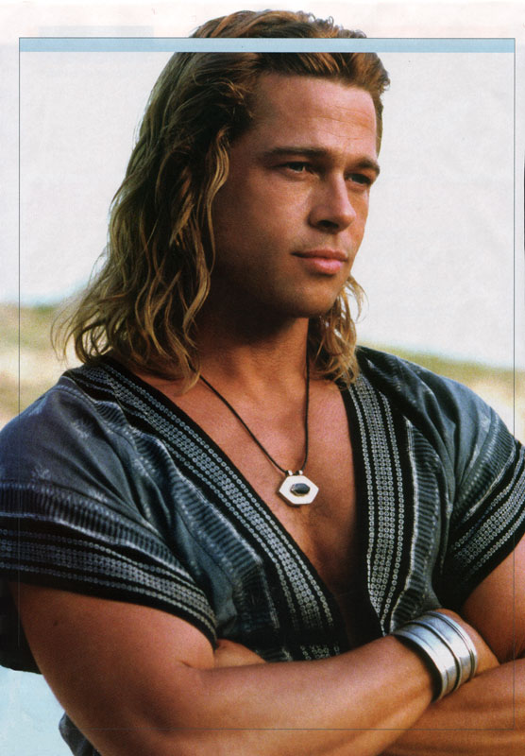
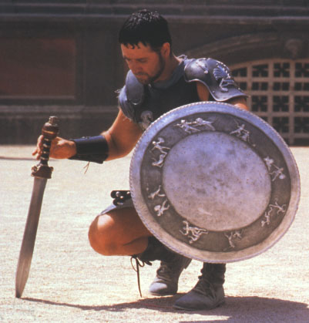
The tragic hero
The hero of the story dies!

Slide 15
Coming of age
The main character matures

Slide 16
Man v. Nature
Man struggling against nature

Slide 17
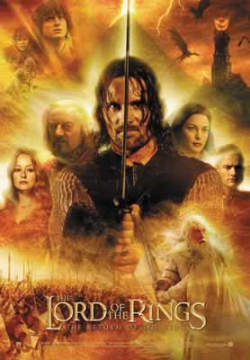
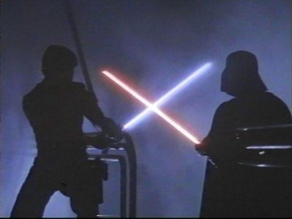
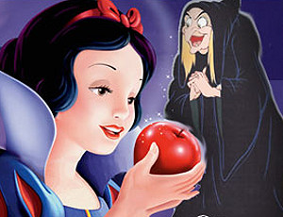
Good v. Evil

Slide 18
Triumph over Adversity
Character triumphs over some adversity

Slide 19
Common universal themes …
Tragic hero
Coming of age
Man v. nature
Triumph over adversity
Good v. evil

Slide 20
Can these themes fall under one of the universal themes?
The only person you can trust is yourself.
It is important to follow your instincts.
Man is inherently evil.
Man is inherently good.
It is not always good to list to society.
It is important to never give up.
The innocent aren’t always traeted fairly.
It is important to stand up for what you believe in.
Be careful who your friends are.
Trust your instincts.
Do what you must to survive.
Follow your dreams.
Life doesn’t always have happy endings.
The force is a metaphor for spirtuality.
The force is the engery that binds all life together.

Slide 21
Your turn …
It’s a Race!
You have 2 minutes to write down …
The names of books you’ve read or movies you’ve seen and the universal theme in the story.

